Slide 1
Virtual Box
VirtualBox is a powerful x86 virtualization product for enterprise as well as home use. Not only is VirtualBox an extremely feature rich, high performance product for enterprise customers, it is also the only professional solution that is freely available as Open Source Software under the terms of the GNU General Public License (GPL).
Prof. Ju-Hong Lee, Data Science Lab, Inha Univ

Slide 2
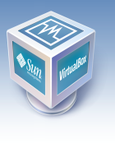
What is Virtual Box?
Virtualization System
It is freely available as Open Source Software
GNU General Public License (GPL).
Presently, VirtualBox runs on
Windows,
Linux,
Macintosh and
OpenSolaris

Slide 3
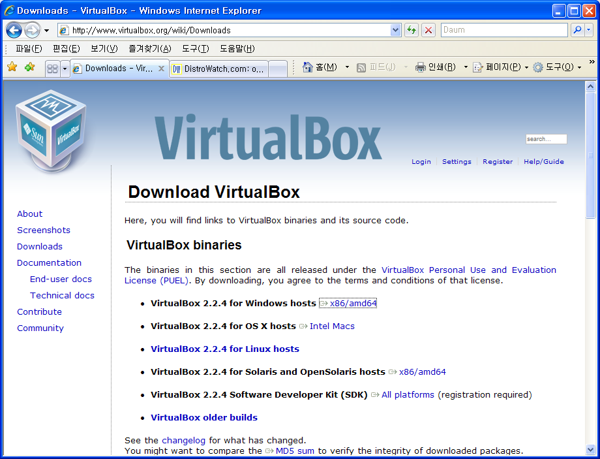
Download and Install
http://www.virtualbox.org/

Slide 4
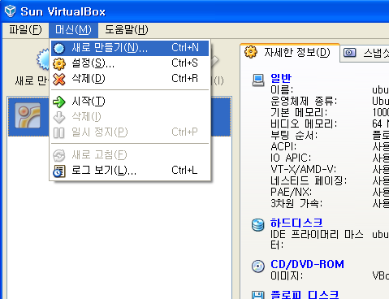
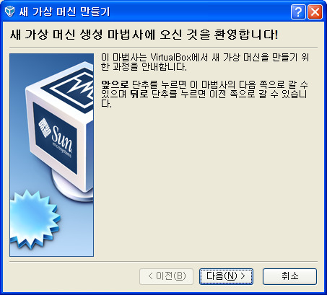
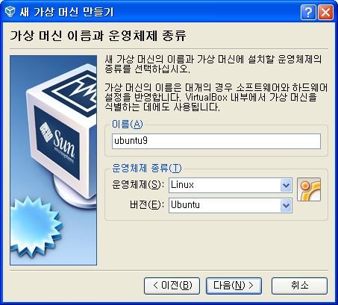
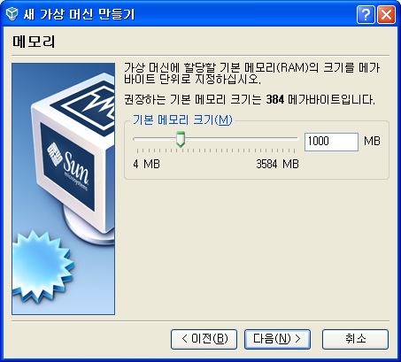

Slide 5
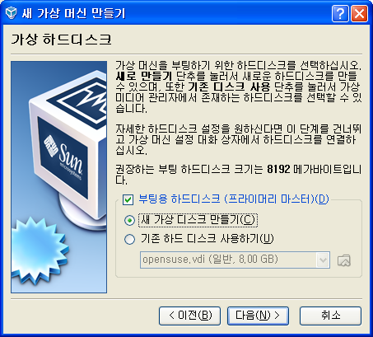
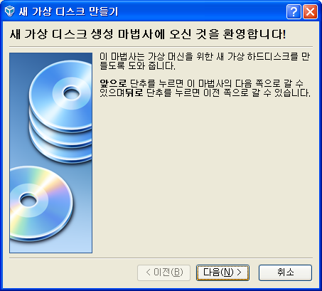
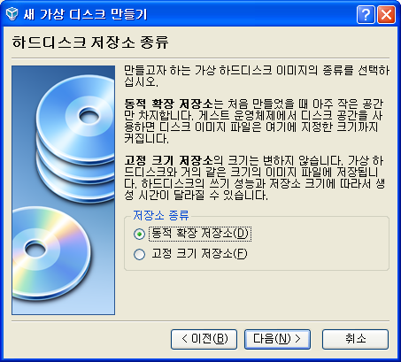
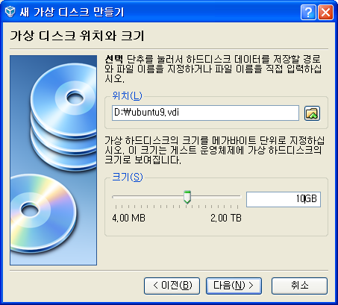

Slide 6
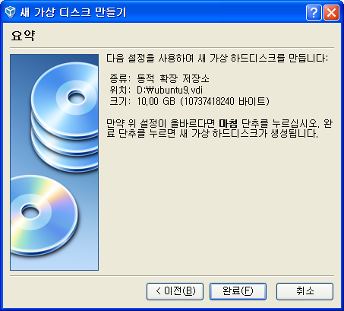
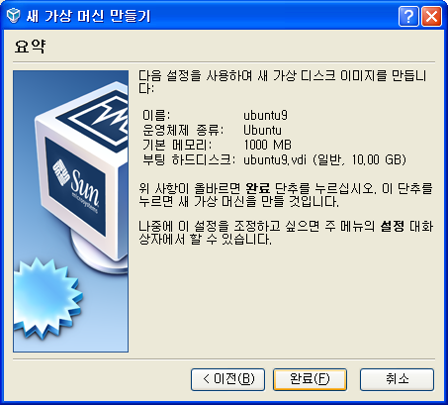
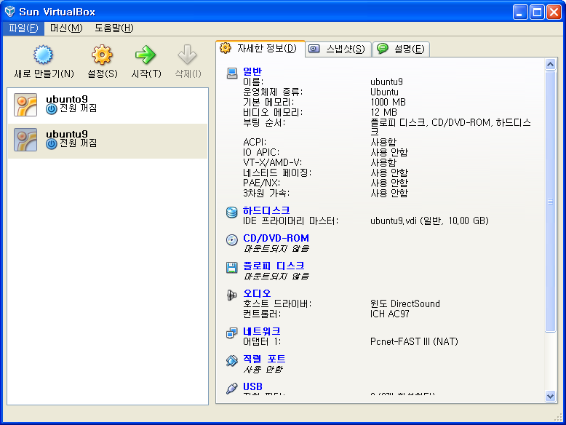
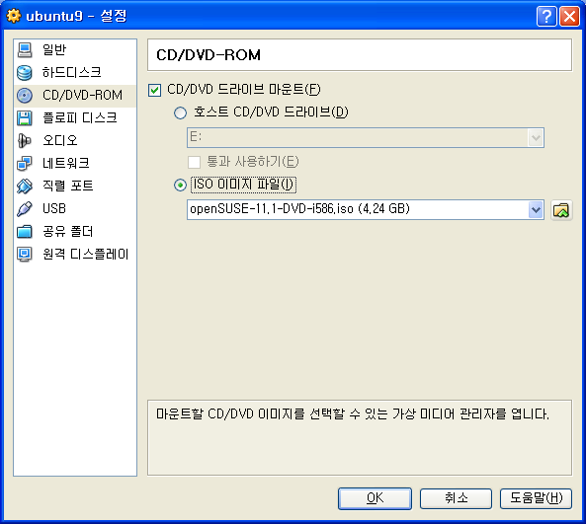

Slide 7
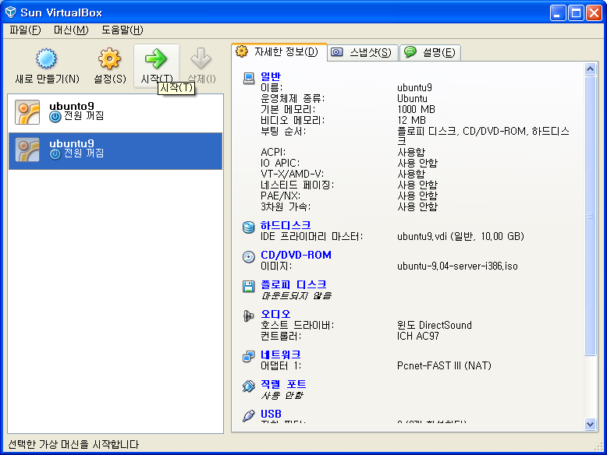
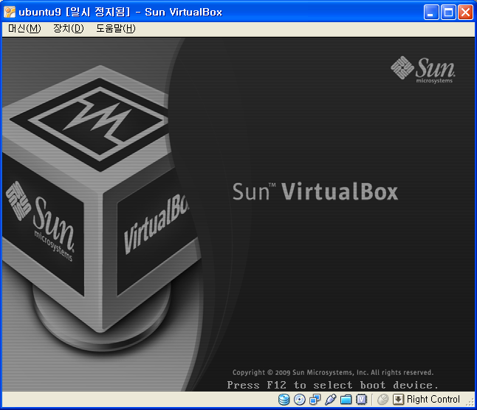
From now on, Install Linux on your configured virtual system.

Slide 8
Linux or Unix Download
Download Site
http://www.ubuntu.com/
http://fedoraproject.org/
Other Distribution releases
Distribution ranking : http://distrowatch.com/

Slide 9
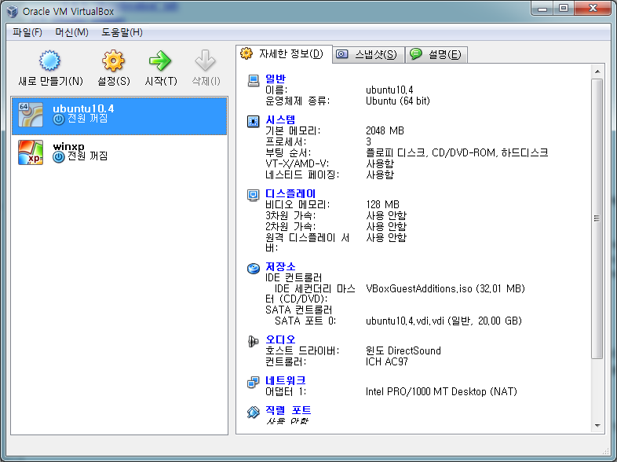
After Install
You should install Guest Addition CD on your installed system.
It includes useful utilities for communicating with the host system or with other guests.

Slide 10
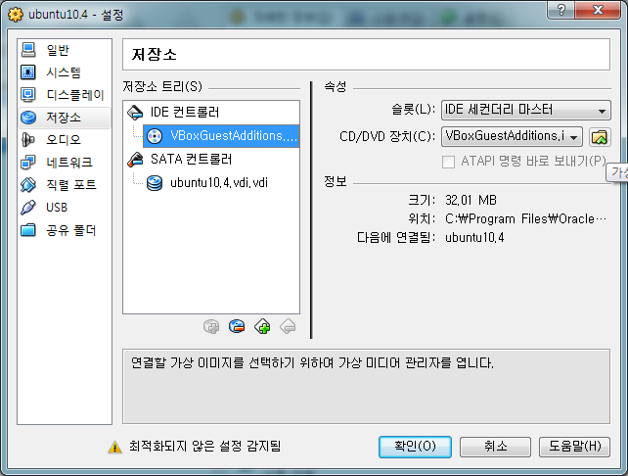
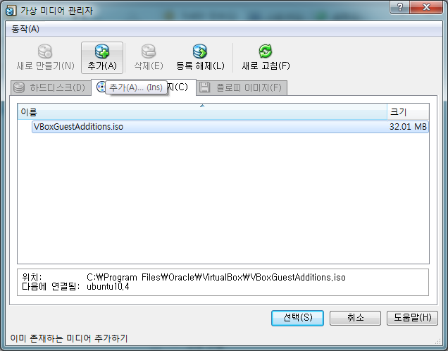
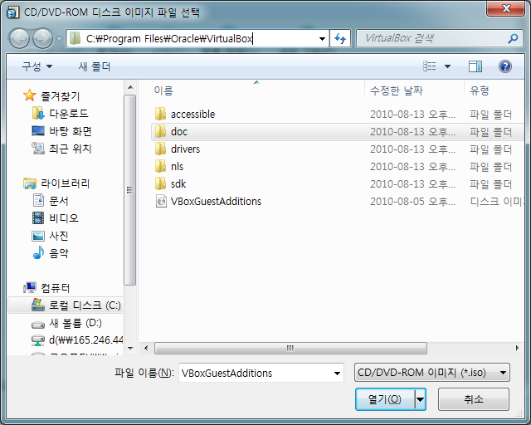


Slide 11
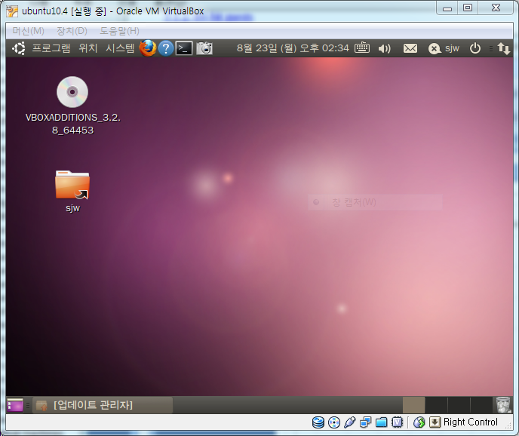
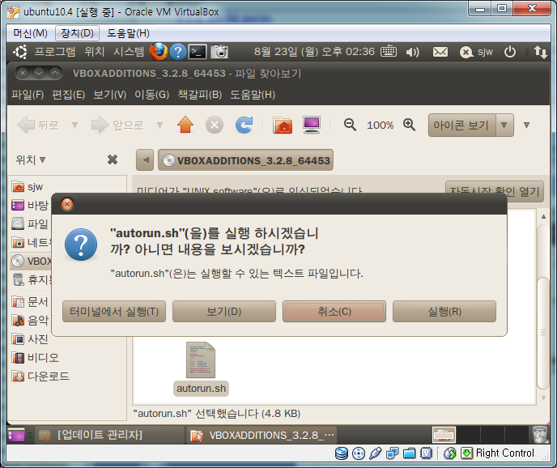
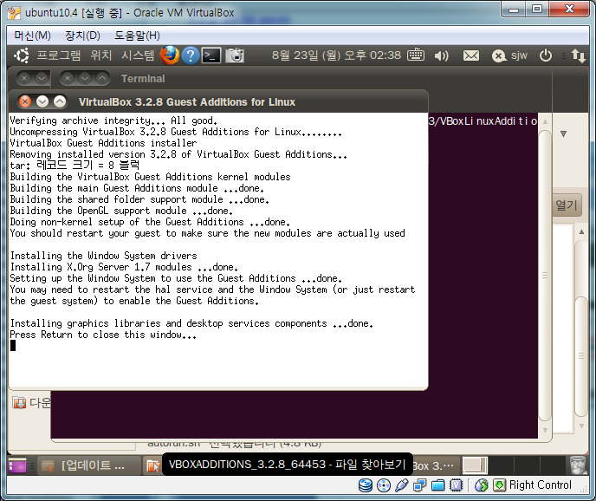
Rebooting

